Slide 1
Housekeeping…
We’ll (always) kick things off at 5 after.
Today:
Hopefully get the infrastructure setup for everyone.
GitHub and pulling workbooks.
Basic stats and code.
Next time:
More GitHub – pushing, assignments, submissions.
Assignment 1 and test assignment intro.
Mo’ stats and code.

Slide 2
Data 3450: Stats For Machine Learning in Python

Slide 3
About me
Education:
Computer Science
Education – Secondary Math
MBA
Work:
About 12 years in corporate learning technology.
Enterprise software rollouts, LMS admin, Building of training programs.
Relevant for this: mainly building reports, analytics, ETL pipelines for data, and visualizations.
Fun:
I travel, cook, and sports.

Slide 4





More about me
I love to travel, and I love sports – mainly NBA and NFL

Slide 5
About the Course
This course covers the foundations of statistics that are relevant to machine learning.
Describing data, relationships, probability, distributions…
We’ll cover these stats concepts through programming in python.
Towards the end of the semester, the stats will build into the beginnings of machine learning.
Stats is the foundation of machine learning – understand the theory.
Stats help inform model decision making and tuning.
Stats help us understand processing and preparing data.
In ML we don’t need to be stats experts to do it, but we do need stats to do well efficiently.

Slide 6
Logistics
Most classes will be:
A bit of new content – lecture, example, etc…
Walk through some hands-on examples.
Work through some practice examples and ask questions if there are problems.
Key content:
Textbook and workbook
In-class workbooks
You’ll need to program, likely beyond what you do in classes. The demand for this will vary between people depending on experience and background.

Slide 7
Assignments and Grading
Assignments
4 Assignments. 25% Total. Largely open-ended programming assignments.
Quizzes
3 Quizzes. 20% Total. Largely statistics theory, some calculations.
Exams
2 Exams. 30% Total. Largely determinative programming challenges.
Project
1 Project. 25% Total. Larger scale assignment, done in small teams.

Slide 8
We Got a Bunch of Rules…
We have several new policies laid down last week.
Extensions and deferrals are banned without an accommodation plan or school exemption.
We aren’t allowed to record classes since that’s a modality change.
No AI usage for anything that is being evaluated/graded.
We’ll discuss this more, but I have to choose a fixed restriction and AI will make you dumb.
I have no idea why these more rigid rules exist, I don’t understand all of the logic, but I have new bosses and those are the rules.

Slide 9
Basics of Statistics

Slide 10

I’m here to learn cool AI Stuff, not Boring Stats. WTF?

Slide 11


Slide 12
What is Machine Learning?
ML is a (the largest?) branch of AI – learning without direct instruction.
In machine learning we don’t tell the computer what to do.
We provide examples of what has happened.
The machine uses some math to determine a pattern of inputs->outputs.
When given a new example, the machine can predict the output.
For example, a loan – we have old paid/unpaid loans, we have info on applicant.
LLMs like ChatGPT are basically ‘next word’ predictors.
Input is text up to that point.
Output is the next ‘word’.
Machine learning models learn to predict based on past data, not direct instruction.

Slide 13
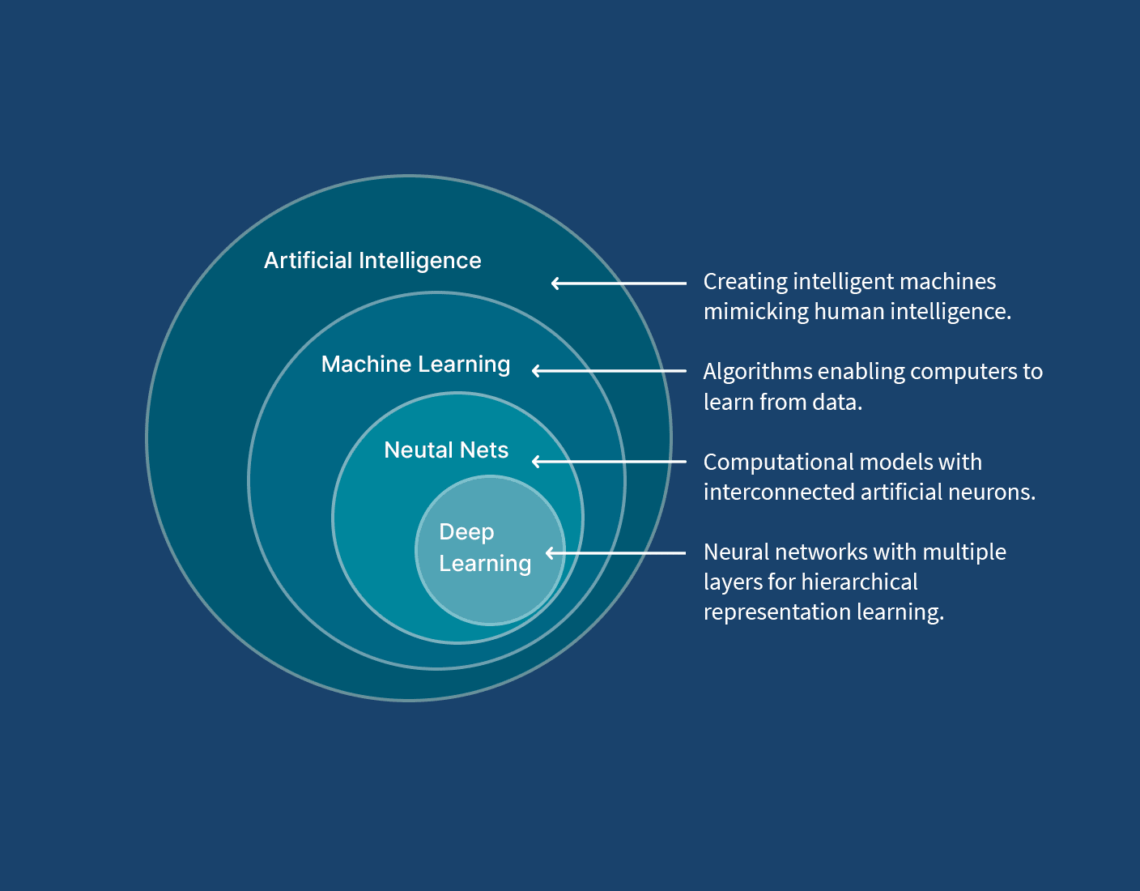

Slide 14
How Do you Machine Learn?
In ML our focus is on the ‘pipeline’ of data.
We need to provide the old examples to the machine to train.
We need to process the data to make it useful, that needs stats.
E.g. removing outliers.
We need to select the correct model for the machine to train.
Different models will perform differently, for mathy reasons.
We need to interpret the results and adjust things, again largely using stats.
To do ML we need stats to help guide us, not normally as a prerequisite.

Slide 15
What is Statistics?
Statistics is the language of data.
Statistics is what we use to describe, organize, analyze, and present data.
We deal (usually poorly) with stats all the time:
If you’ve taken the average of some values, you’ve done statistics.
Polling is stats.
Evaluating vaccine efficacy is stats.

Slide 16
Describing Data
The simplest stats are those to describe data – mean, median, max, etc…
We can also describe the ’shape’, or distribution, of data.
This helps us communicate with others, process data for ML, and interpret results.

Slide 17
What is Probability?
Probability is the math of predicting how likely something is to happen.
If you’ve ever gambled, you’ve used probability.

Slide 18
Statistics + Probability
Statistics and probability are like peas in the same pod!
What if we….
Collect a lot of data (statistics).
Do some analysis to look for patterns or trends in that data (statistics).
Use what we’ve learned from that data to make predictions (probability).
This entire area is called Inferential Statistics – using stats to create predictions.
Moving into machine learning, we will take some datasets, and use the probability of things occurring in our data to build tools to make predictions for the future.

Slide 19

But How Does That Work?
Assume you work for Nike, you’re the boss of all of Nike. You make shoes.
For each shoe, you need to make it in a bunch of different sizes.
How many pairs do you make for each size?

Slide 20
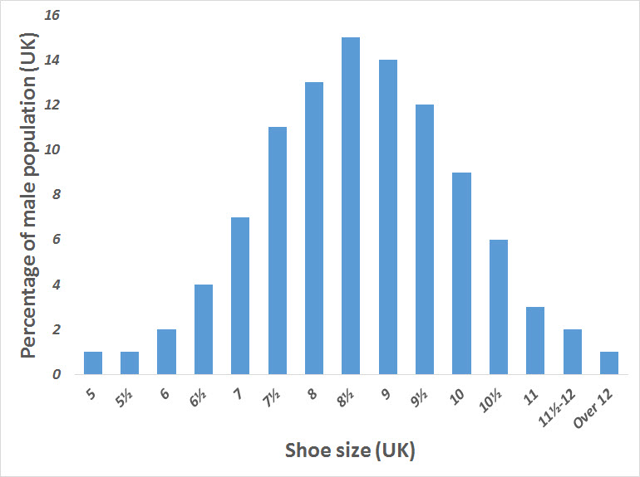
Stats and Probs to the Rescue
Collect data on shoe sizes of the population. (Statistics)
This might come from some sort of survey, medical records, or more likely, old shoe sales records.
Analyze your data to count how many people wear each size. (Statistics)
Translate those counts to likelihood – e.g. if 13% of people wore a size 9, we should expect that apx 13% of our shoes should be a 9. (Probability)
Would basketball shoes be different from ballerina shoes?
More data -> more fine grained projections.

Slide 21
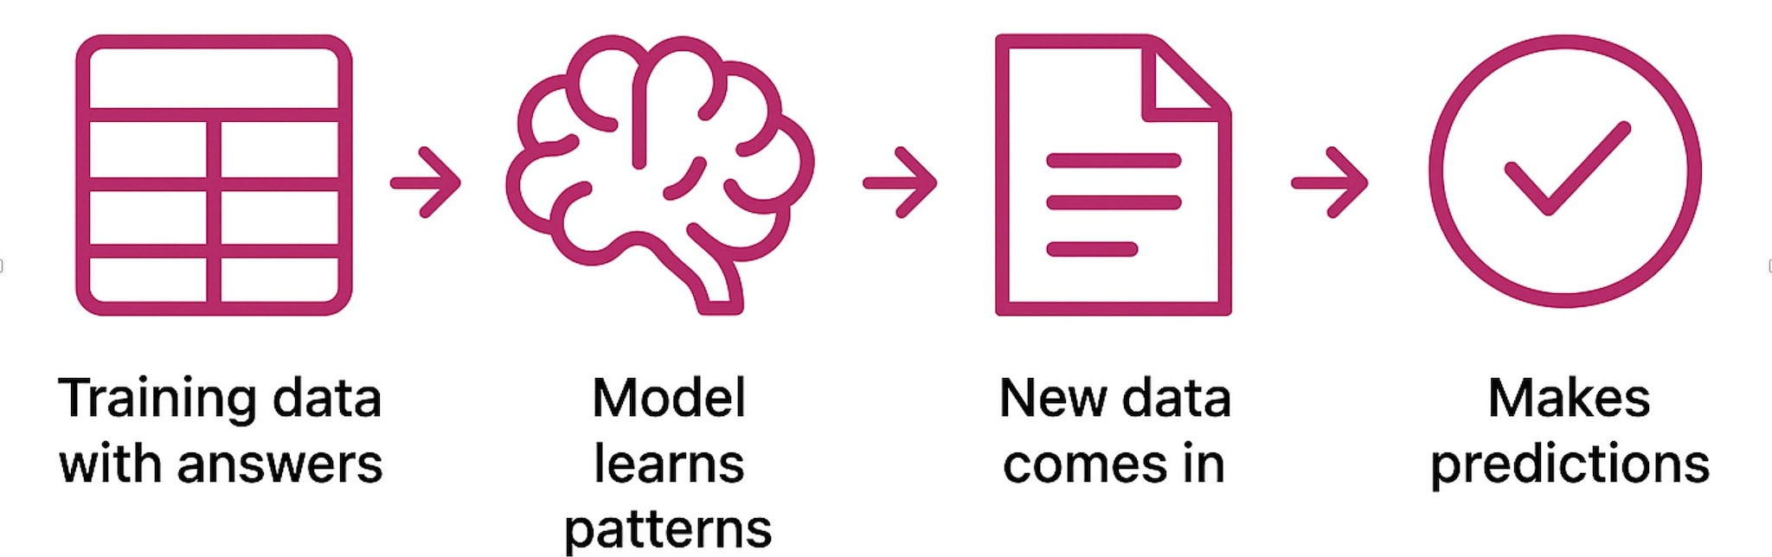
Ok, Cool Bro, But I’m Still Waiting for the AI Part
That interaction is the core thing that allows analytics (data mining/machine learning/AI) to function.
When creating predictive models we do the same thing, only the computer does the heavy lifting:
Point the algorithm at the data.
The algorithm does some fancy math (just like our chart), and learns how to make predictions.
The outcome of this is what we call a predictive model. It takes in some data, and spits out a prediction.
We can use that model to make predictions for future situations, just like choosing shoe sizes to make.
Predictive analytics is basically just applied statistics!

Slide 22
Still Not Seeing The Need for Stats?
Understanding stats and probability helps us understand what we are doing with analytics.
Understanding of the foundations of machine learning concepts.
Diagnose errors, problems, or poor performance.
Communicate efficiently with others (stats is the language of data).
Make better and faster decisions on what data and techniques to use.
Evaluate results more comprehensively.
Make more accurate predictive models!
Knowing stats is useful in society, things like ‘likelihood’ are a mystery to most.
Knowing stats isn’t strictly necessary to do analytics, but to do it well, it is.
The more advanced you get in ML, the more likely stats will matter.

Slide 23
Conclusion
Statistics is the (sometimes invisible) foundation for the work of machine learning.
Understand and describe data.
Prepare and asses the usefulness of data to feed ML models.
Learn (some of) the theoretical underpinnings of ML models and processes.
Interpret results.
Coding – do more of it.
ML requires us to code, similarly how reporting requires us to write.
You don’t need to be an amazing programmer, but you do need to be competent.
Practice is by far the most important thing - try stuff. It will be somewhat frustrating, that’s normal.
Attempt to look up documentation or examples and adapt – that is what you’d do in reality.

Slide 24
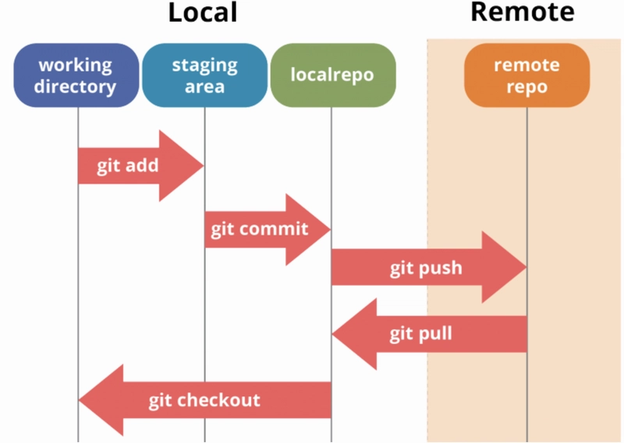
GitHub Basics
GitHub is basically an online repository for code (version control).
Central repository, and can make copies that can be synched.
Copies can be developed on their own, or changes merged back with the central repository.
Most larger sw is developed with this or similar.
Key function is keeping files in sync, while being edited:
Multiple editors can work on one program, and sync their changes together in a central repository.
Workbook repository:
I push updates, you pull them.
Your assignments/work:
You copy (fork) a repository, work on it, and push changes to your own version.

Slide 25
Setup - What do I need to Get and do?
Bad news – there is a bunch of stuff needed for the course.
Good news – it is all free and most of it is also used in industry.
Worse news – getting everyone setup and ready to go can be annoying, and you’ll all probably hate me by the end of today. It does get better though!

Slide 26
Let's get Setup…
There’s a link to Anaconda on Brightspace (or google Anaconda Data Science).
This will have most of the things that we need to install.
Details will/may vary depending on what you already have on your PC.
You might need to install ‘git’ or maybe vs code separately.
Create accounts – GitHub.
Basics of VS Code.
Pull copy of workbook repository – link on Brightspace.
A little practice in code.

